Slide 1
Spotify – Team 9
William Burke, Grant Perkins, Cameron Tomko, Connor West
Notes:
Grant

Slide 2

Background on Spotify
"Music for Everyone"
More info:
Music streaming industry
Apple Music, Amazon Music, YouTube Music, TenCent
Music, podcasts, audiobooks
Free and premium services
43% of users are premium users (195 million)*
Source: https://techjury.net/blog/spotify-statistics/#gref
Notes:
Spotify is a music streaming service based in Stockholm, Sweden.
They were founded in 2006, with the goal of music for everyone.
Their main market is music streaming, but they also have podcasts and audiobooks available.
There is both a free and a paid tier for their service, with the paid tier being $5-10 a month, this allows for features like ad free streaming and better audio quality.
Currently 43% of their users are in a paid subscription

Slide 3

Current Status
These findings are based off job postings and other externally available data:
Spotify does not use Excel for their business intelligence
Spotify uses data warehouses and databases
Spotify uses IIS like Luigi, Hadoop, and Pig for data integration
Spotify has an extensive business intelligence department
Spotify mainly uses Luigi to construct data pipelines, Luigi is an opensource framework for complex data pipelines including different script types and visualizations
Spotify is a stage 5 BI driven company
Notes:
In our research we also investigated the current state of Spotify’s business intelligence. While they don’t publish their internal procedures, we were able to gather an idea of what procedures they might use through data analysist job postings and older published information.
Integrated information systems
Spotify uses BI in it’s commercial services to recommend music
This increases customer satisfaction and increases music streams and premium memberships
This is a fully automated process with no user interaction required
Spotify contains multiple business intelligence teams with different purposes, both external and internal

Slide 4


Summary of Case Studies
Amazon’s Recommendation Engine
Netflix’s House of Cards
Services are Amazon Pay, Amazon Web Services, Amazon Pantry, and Amazon Online Shopping
Leverages data using BI to prioritize customer needs
Uses a collaborative filtering engine for a personalized recommendation system
Netflix Original Series
Used media data to create show
Implemented BI in decision making when drafting plans
Showcases how BI can be used to understand what is popular among different audiences
Notes:
Cam

Slide 5
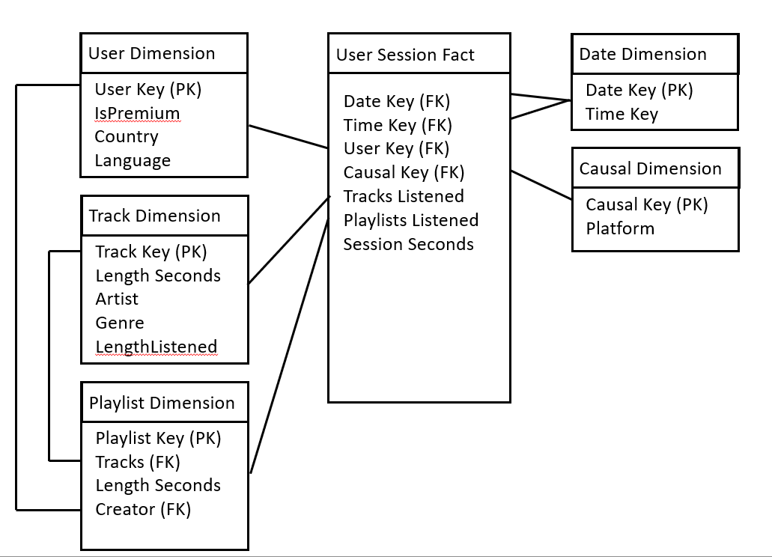
Proposed BI Solution
Our business intelligence solution is built around user session tracking
We created both a tactical and a strategic dashboard
These dashboards allow managers to monitor how Spotify is running, and where they need to improve and adapt
We also performed a data analysis focused on when and why users skip recommended tracks
We belive that our BI soultions will help Spotify make better decisions in the future
User Session Star Diagram
Notes:
Connor

Slide 6
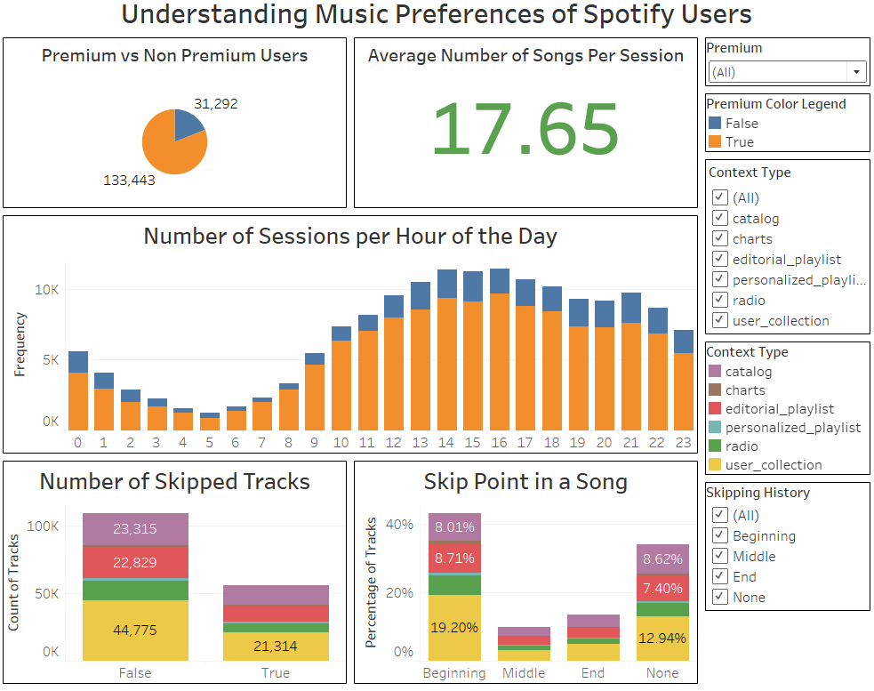
Prototype 1: Understanding Music Preferences of Users
Possible Takeaways
Understanding into the difference in tendencies of premium versus non premium users
Determining skipping points in songs and understanding the context of the song in the session
Enticing non premium users to upgrade
Notes:
Cam
The first dashboard the team created was Understanding Music Preferences of Spotify Users. The dashboard was created to answer the question of ‘How does spotify’s premium account subscription affect the user experience. To understanding user experience, the team defined it as average number of songs in a session, the distribution of sessions throughout the day, and the skipping tendencies of users, targeting at what point in a song and in what context the song is in, meaning a user playlist or a Spotify recommendation, does a user skip a song.
The first metric used on this dashboard is a pie chart which looks at the number of premium vs free account users. Moving to the right, an average number of song per session is presented. The stack bar chart in the middle presents Spotify with an understanding of the time of the day with the highest volume of users. Lastly, the bottom two stacked bar charts provide Spotify with insight about why users are skipping songs and in what context.
The interactive filters on this dashboard allow for toggling between premium and non premium user data, selecting different song context, and looking at the data of song that were skipped or not.
With these metrics and filters, our team has a few takeaways for spotify

Slide 7
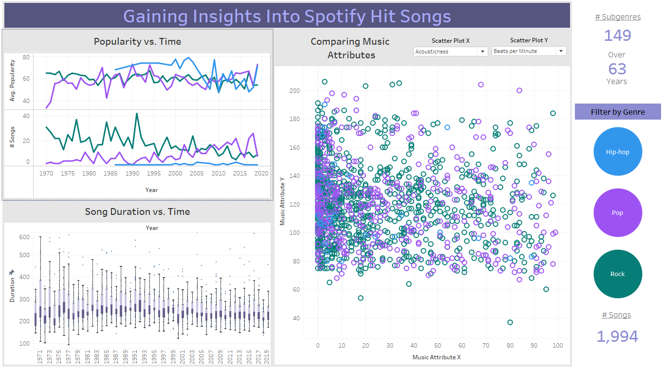
Prototype 2
Notes:
Prototype 2:
- This is a dashboard I made with a dataset of some of the top 2000 songs ever on Spotify with their popularity scores.
- The dashboard focuses mostly on the three genres you see on the right
- The major metrics are

Slide 8
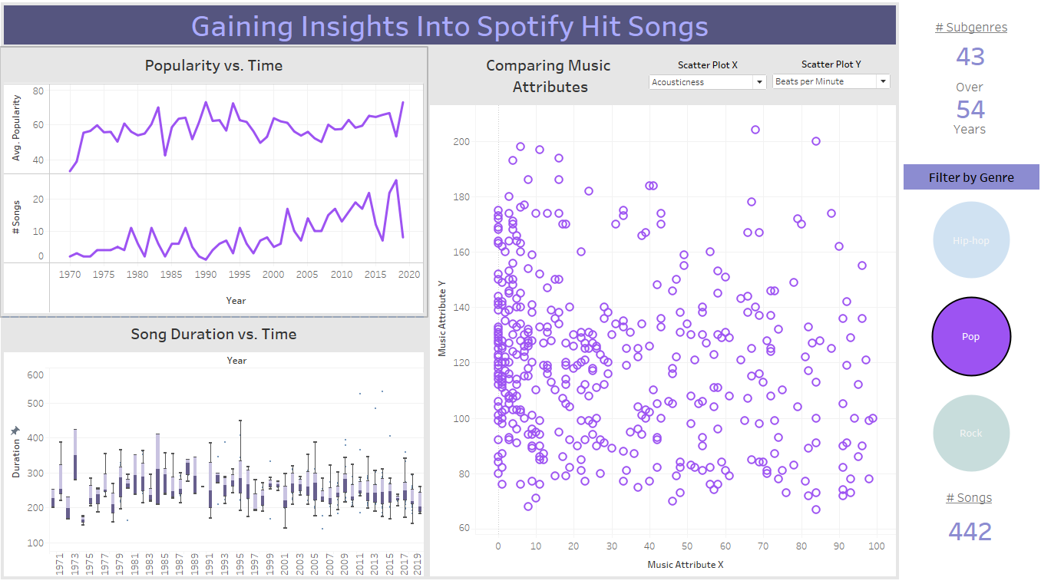
Prototype 2 (cont.)
Possible Takeaways
Song duration?
Successful genres?
Can valuable info be obtained from music attributes?
Notes:
Will
Question to answer: Can spotify use this information to make successful platform specific content
This is a different view of the dashboard with the filter applied to pop songs
Song duration -> the idea time was between 3:40 and 4:20
The best genre is pop. A lot of songs landed in top 2000 and trending upwards
Music attributes were interesting to visualize, but optimal combinations of these values would require ML or DL

Slide 9
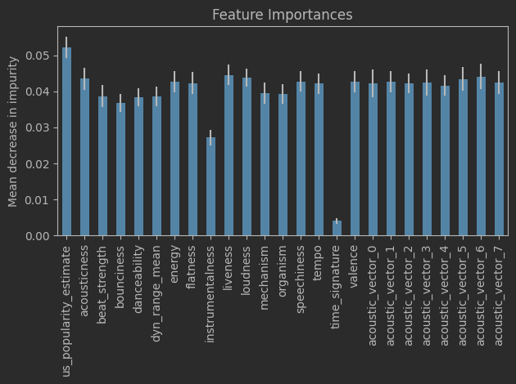
Prototype 3: Data Analysis
Complex data analysis can be used to answer more difficult questions
Example: why are users skipping songs?
Method:
Predictive analytics
Collect track data from data warehouse
Train a machine learning classifier on song qualities to predict if the average user skips the track
Results:
63% accuracy
Average US popularity matters
Time signature does not matter
This approach can be used in a variety of cases, such as predicting employee retention
Notes:
Grant

Slide 10
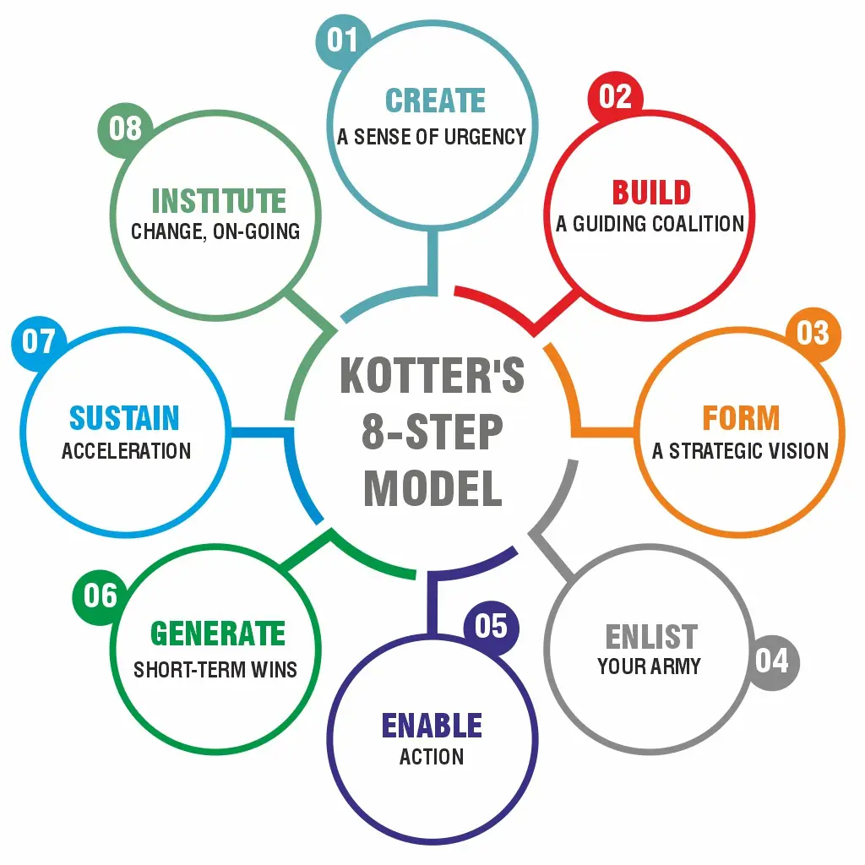
Implementation: Managerial
Kotter's Eight Step Process
Prepare
Spotify could lose customers!
Set up leadership
Create a plan/"vision"
Implement
Communicate to employees
Remove obstacles
Short-term goals
Manage
Continuously improve
Institutionalize new approaches
https://www.kotterinc.com/methodology/8-steps/
Notes:
Grant

Slide 11
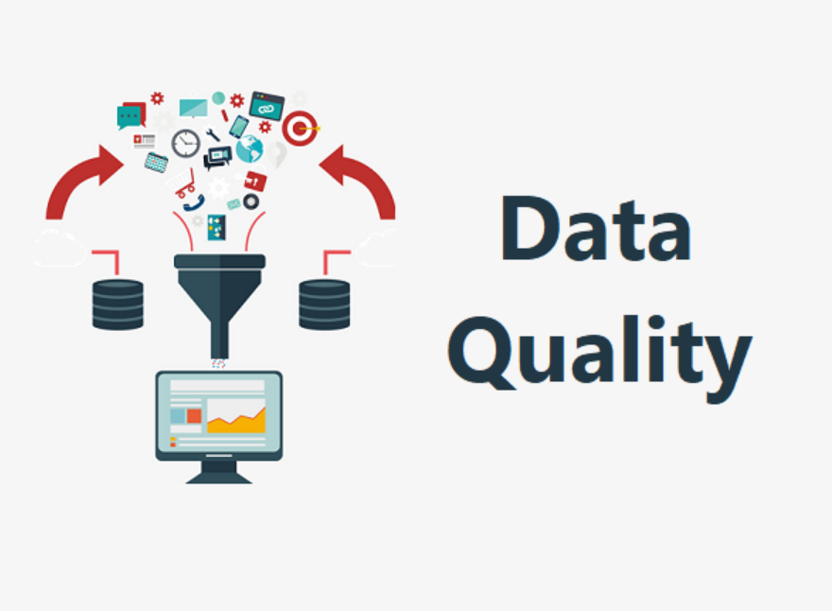
Implementation: Technical
Data Quality Issues
Very few at Spotify
Duplicate tracks
Fake accounts
Podcast or song
Notes:
Grant

Slide 12

Implementation: Ethical
Data Security and Data Privacy Concerns
Targeted advertising
Data sold to third-party companies
Misuse of customer data
Solution:
Transparent about data practices through terms of service
Store data securely and anonymously
Create information security team
Notes:
Cam

Slide 13

Conclusions
Spotify’s Current State
BI Approach & Data Warehousing
Analytical Takeaways
Notes:
Will
We looked at the current state of Spotify and learned about their impressive use of BI, and we also looked into different organizations through case studies
We made direct recommendations for their business intelligence involving improvements to Data Warehousing
We delivered several specific analytical tools including
(1) dashboard to be used for analyzing the relationship between premium and non premium
(2) dashboard that analyzes hit songs to encourage efforts into platform-original content creation
(3) Predictive modeling to better understand listener interests

Slide 14
Thank you for attention!

